Slide 1
STRATEGY FOR IMPROVEMENT OF MATHEMATICS RESULT
Class X
BY
Academic Support Group

Slide 2
RESULT ANALYSIS OF CLASS X HAS SHOWN THE FOLLOWING TRENDS :-
CBSE Results of class X & XII have gone up continuously upto 2004
Results have declined in 2004-2005 in almost all the districts
Subjects mainly responsible for this decline are
      Mathematics
      Social Science
      English
Result analysis reflects that a student who is able to pass in Mathematics has fairly good chance to get through in other subjects too.

Slide 3
FACTORS RESPONSIBLE FOR POOR RESULT IN MATHEMATICS
Phobia of Mathematics among students
Poor Previous Knowledge
Poor Calculation Skills
Lack of practice in mathematics
Faulty Methods of Teaching

Slide 4
FACTORS RESPONSIBLE FOR POOR RESULT IN MATHEMATICS
Poor Quality of Assignments
Improper Checking of Assignments
Insufficient follow up of correction work
Lack of practice in attempting the question paper
Non identification of easy scoreable areas

Slide 5
STEPS FOR IMPROVEMENT
Stress on Mental Mathematics in order to improve calculation skills and reduce phobia
Introduction of short Bridge Courses
Encouraging practice in class and at home
Discouraging use of help books
Using appropriate method of teaching for various areas of the subject
Assignments based on application from outside the text book and with changed numerical values be given

Slide 6
STEPS FOR IMPROVEMENT
Improving quality of checking of assignments and tests eg. highlighting mistakes
Ensuring follow up of correction work by the students
Increased number of tests based on Board pattern
Development of strategy of attempting the question paper eg.attempting the easier questions first

Slide 7
ACCOUNTABILITY OF TEACHERS
Result analysis will now be done teacher-wise
Teacher-wise result analysis will be monitored by HQ
Necessary action will be taken for poor result

Slide 8
STEPS TAKEN TO IMPROVE BOARD RESULTS

Slide 9
PRESENT SCENARIO
Performance of students of govt.schools of Delhi in CBSE not up to the mark
Constant need of efforts to improve Board results with focus on class X
Result analysis shows that mathematics is the weakest area

Slide 10
What is being done…
Department of Education is committed to improve upon the Board results. Many efforts are in motion

Slide 11
Steps taken so far…
Zero period for weak students of Class X and XII
Unit Tests on every Monday in all schools for all subjects in rotation
Preparation and distribution of Question Banks to students (Free of cost)

Slide 12
Steps taken so far…
Stress on proper correction and application based assignments
Results of unit tests to be monitored and conveyed to parents
Special seminars in subjects like mathematics which is identified as main cause of poor results

Slide 13

How to score more
in
Mathematics?

Slide 14
PRESENT SITUATION
Poor result of Mathematics is the cause of decline in Board result.
Improvement in Mathematics result is essential for improvement of class X result.
Responsibility for improvement lies on the Mathematics teachers.

Slide 15

NEED OF THE HOUR
To improve the result quantitatively i.e. increase the number of students passing.
To pull up the students obtaining 20 marks or so to the pass marks level.
To improve the result qualitatively i.e. enable students to clear competitive exams.

Slide 16
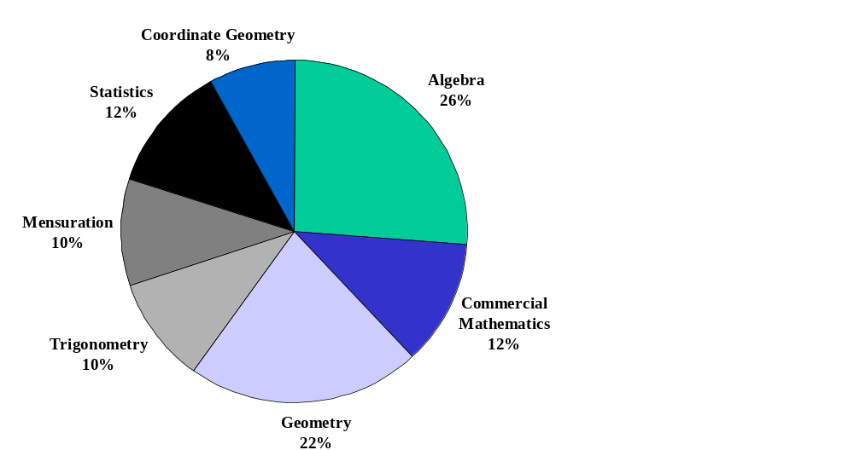
WEIGHTAGE TO SUBJECT UNIT

Slide 17
BLUE PRINT
Time: 3 Hours M.M 100
CONTENT AREA | NUMBER OF QUESTIONS OF
 | 3 Marks | 4 Marks | 6 Marks
I. Algebra 26 (8)
1. Linear Equations 7 (2) | 1 | 1 | -
2. Polynomials 3 (1) | 1 | - | -
3. Rational Expression 3 (1) | 1 | - | -
4. Quadratic Equation 7 (2) | 1 | 1 | -
5. Arithmetic Progression 6 (2) | 2* | - | -
Sub Total 26 (8) | 6 | 2 | -
II. Commercial Mathematics 12(3)
1. Instalments 6(2) | 2 | - | -
2. Income Tax 6 (1) | - | - | 1
Sub Total 12 (3) | 2 | - | 1
Continued …

Slide 18
BLUE PRINT
CONTENT AREA | NUMBER OF QUESTIONS OF
 | 3 Marks | 4 Marks | 6 Marks
III. Geometry 22 (5)
1. Similar Triangles 9 (2) | 1 | - | 1*
2. Circles 9 (2) | 1* | - | 1
3. Constructions 4 (1) | - | 1 | -
Sub Total 22 (5) | 2 | 1 | 2
IV. Mensuration 10 (2) | - | 1 | 1*
V. Trigonometry 10 (2) | - | 1* | 1
VI. Statistics 12(3) | - | 3 | -
VII. Coordinate Geometry 8 (2) | - | 2 | -
Sub Total 40 (9) | - | 7 | 2
GRAND TOTAL 100 (25) | 10 | 10 | 5
Summary:
Number of Questions of 6 Marks: 5
4 Marks: 10
3 Marks: 10
* Indicates Internal Choice

Slide 19
Weightage to Difficulty Level of Questions
S.No | Estimated Difficulty Level of Questions | Percentage of Marks
1 | Easy | 15%
2 | Average | 70%
3 | Difficult | 15%

Slide 20
Scheme of Options
All questions are compulsory i.e. there is no overall choice in the question paper.
However, internal choices have been provided in two questions of 3 marks each, two questions of 4 marks each and two questions of 6 marks each.
These choices have been given from within the same topic and in questions which test higher mental abilities of students.

Slide 21
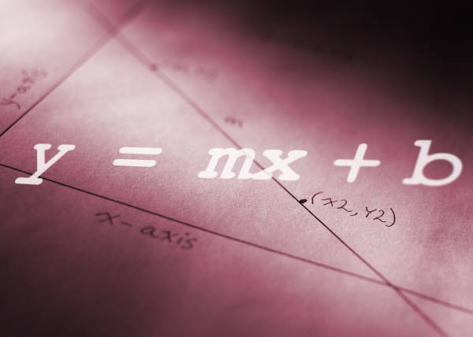
ALGEBRA

Slide 22
ALGEBRA
Sub-Topic : Linear Equations in two Variables
Value Points :– 7 (3+4)
Type of Expected Questions | Marking Scheme | Common Mistakes committed by students | Points to be Emphasised | Rating/ Marks
1. Solve the Simultaneous linear equations | i. Solving the equation (any method) 2 ii. Writing answer as x =--- y =--- 1 | i. In Elimination method, while subtracting the second equation from the first equation the students do not change the signs of terms of the second equation. ii. They do not write answer separately. | i. Should change the sign of terms of second equation from first while subtracting ii. Answer should be written separately as x =------and y=-------- | Easy 3
2. Graphical Method | i. Preparing the tables for each equation ½+½ ii. Plotting the graph correctly for each equation 1+1 iii. Writing the solution as answer as x=----, y=--- 1 | i. Students use separate Graph sheet for each equation ii. Do not write the solution as answer iii. Some times students mark x axis as y axis & vice versa & so plot the points wrongly | i. Marking both the axis correctly ii. Finding the co- ordinates of point of intersection of the lines plotted iii. Finding the point of intersection of any plotted line with x- axis or y- axis correctly. | Easy 4

Slide 23
ALGEBRA
Sub-Topic : G.C.D. & L.C.M. OF Polynomials
Value Points – 3 (1)
Type of Expected Questions | Marking Scheme | Common Mistakes committed by students | Points to be Emphasised | Rating/ Marks
1. Find the G.C.D. and L.C.M. | i. Factorisation of polynomials 1+ 1 ii Writing G.C.D. and/or L.C.M. 1 | i.. While splitting the middle term they do not write signs (+ or -) correctly | i. Splitting of the middle term for factorisation | Easy 3
2. Finding the constants a and b if G.C.D. is given | i. Factorisation of G.C.D 1 ii. Finding value of ‘a’ 1 iii.Finding value of ‘b’ 1 | i. While using remainder theorem they do not substitute the value of x in the equation correctly , e.g. for an equation x²+x-12 if x-3 is a factor, then value of x should be substituted as (3)² +(3) – 12 instead of writing directly as 9+3-12 | i.Proper use of remainder theorem i.e. if f(a)= 0, then (x - a) is ‘a’ factor of f(x) ii.Enough practice should be given on using remainder theorem for finding a & b | Average
3. Based on formula G.C.D. X L.C.M = p(x) X q(x) | i. Writing the formula correctly 1 ii. Simplifying & getting correct answer 2 | i. Do not write the formula correctly ii. Do not write the answer in simplified form | i.Enough practice should be given to use the formula correctly ii. After factorisation the answer should be in lowest form

Slide 24
ALGEBRA
Sub-Topic : Rational Expressions
Value Points – 3 (1)
Type of Expected Questions | Marking Scheme | Common Mistakes committed by students | Points to be Emphasised | Rating/ Marks
Reduce to the lowest form | i.Factorisation of Polynomials 2 ii. Writing the answer in simplified form 1 | They do not write the answer in simplified form i.e. lowest term | i. Answer should be written in lowest terms ii. Practise should be given in factorisation of polynomials by splitting the middle term | Average

Slide 25
ALGEBRA
Sub-Topic : Quadratic Equations
Value Points – 7 (3+4)
Type of Expected Questions | Marking Scheme | Common Mistakes committed by students | Points to be Emphasised | Rating/ Marks
1. Solve the equation | i. Writing the values of a, b, c 1 ii. Writing the formula and substituting the values of a, b, c correctly 1 iii.Simplifying and arriving at correct answer 1 | i. Do not write + or – signs with the values of a, b and c ii. Do not write the value of sq. root of discriminant (D) correctly | i. Substituting the correct values of a, b, c in D =b²- 4ac ii. Finding the square root of the number | Average
1. Word Problem on Quadratic equation or linear equation (internal choice) | i. Assuming variables ½ ii. Forming the Equation 1 iii. Arriving at Quadratic equation 1 iv. Factorisation 1 v. Writing the answer ½ | i. Students are unable to even form the equations | i.They must be given enough practice in forming the equation | Difficult

Slide 26
ALGEBRA
Sub-Topic : Arithmetic Progression (AP)
Value Points – 6 (3+3)
Type of Expected Questions | Marking Scheme | Common Mistakes committed by students | Points to be Emphasised | Rating/Marks
1.Finding the n^{th} term | i. Use of correct formula 1 ii. Correct substitution of values 1 iii. Finding the required term 1 | i. They do not use the formula correctly ii. Calculation mistakes iii. In writing the nth term they forget to subtract one from n e.g. for finding 20th term they write a₂₀=a+20d instead of a₂₀ =a+19d | i. Learning and application of the correct formula ii. Short method should be used to find the n^{th} term if sum to n terms is given | Easy 3
Finding the Sum of n terms i.e. S_{n} | i. Writing ‘a’ and ‘d’ from the given A.P. 1 ii. Writing the formula of S_{n} 1 iii. Finding S_{n} as solution 1 | Sometimes they use last term ‘l’ as ‘n’ | Stress should be given on the application of correct formula | Easy 3

Slide 27
COMMERCIAL MATHS

Slide 28
COMMERCIAL MATHEMATICS
Sub Topic: Instalments
Value Points: 6 (3+3)
Types of expected questions | Marking Scheme | Common Mistakes committed by students | Points to be Emphasised | Rating/ Marks
1. Finding the amount of instalment 2. Finding the rate of interest 3. Finding the total amount paid or sum borrowed | Question will usually involve three steps 3 | i. Incorrect use of Instalment formulae ii. Calculation mistakes | i. Practice to be given in calculations ii. Instalment question will contain 3 or 4 instalments iii. In questions involving compound interest maximum number of instalments would be three | Easy 6

Slide 29
COMMERCIAL MATHEMATICS
Sub Topic: Income Tax
Value Points: 6 (1)
Types of expected questions | Marking Scheme | Common Mistakes committed by students | Points to be Emphasised | Rating / Marks
1. Find the total income tax to be paid 2.Find the tax to be paid in the last month | i. Usually the question will have major 6 steps of calculations 6 | i. Calculation mistakes ii. Advance Tax is multiplied by 12 Instead of 11 iii. Education CESS is applied after subtracting the advance tax iv. Education CESS is subtracted instead of adding | i. Student should be taught to subtract correctly for e.g. * 190000 10000 80000 (wrong) 190000 10000 180000 (right) ii. Education CESS to be calculated on the total tax due | Easy 6

Slide 30

Geometry

Slide 31
GEOMETRY
Sub-Topic : Similar Triangles
Value Points – 9 (3+6)
Type of Expected Questions | Marking Scheme | Common Mistakes committed by students | Points to be Emphasised | Rating/ Marks
1.Problem on Similar triangles | i.Correct figure ½ ii. Proof 2 ½ | i.They do not draw the figure correctly ii.Proofs are not relevant to the figure | i.Correct use of relevant similar triangle theorem | Difficult
2. Theorem with rider | i.Figure, given, to prove, construction ½each ii. Proof 2 iii. Rider 2 | i.Sometimes the students write the theorem without drawing the figure, hence get no marks ii.Proof is not relevant to the figure iii. They do not show the angles in the figure mentioned in the proof | i.They should draw the figure first. ii. Explanation should be given according to the figure drawn | Theorem part is easy 4

Slide 32
GEOMETRY
Sub-Topic : Circle
Value Points – 9 (3+6)
Type of Expected Questions | Marking Scheme | Common Mistakes committed by students | Points to be Emphasised | Rating/ Marks
1. Problem based on circle | i.Correct figure ½ ii. Proof 2 ½ | i They do not draw the figure correctly ii. Proofs are not relevant to the figure | Correct use of relevant theorem in circle | Difficult
2. Theorem with rider | i. Figure, given, to prove, construction ½ each ii.Proof 2 iii. Rider 2 | i.Sometime they write the theorem without drawing the figure ii. Proof is not relevant to the figure | i. They should draw the figure first. ii. Explanation should given according to the figure iii. Both the theorem would be out of 10 starred theorem, so repeated practice of writing the theorem is required with correct figure | Theorem part easy 4

Slide 33
GEOMETRY
Sub-Topic : Constructions
Value Points – 4(1)
Type of Expected Questions | Marking Scheme | Common Mistakes committed by students | Points to be Emphasised | Rating/Marks
Construction | i. Correct construction 3 ii. Writing the steps of construction 1 | i.They do not construct angles with the help of compass ii.They do not draw angle correctly iii. They do not draw neat figures | i. They should use sharpened pencils ii. Enough practice should be given for all the constructions in the class itself iii. Angle should be constructed with the help of compass only iv. Use of protracter (D) is not allowed | Easy 4

Slide 34
MENSURATION

Slide 35
MENSURATION
Value Points: 10 (4+6)
Type of expected questions | Marking Scheme | Common Mistakes committed by students | Points to be Emphasised | Rating/ Marks
1.Conversion of solids 2. Mixed figure 3.Frustrum | For 4 marks question i. Formula and substitution of values 1 ii. Solving the problem 3 For 6 marks question iii. Formula and substitution of values 1 iv. Solving the problem 5 | i. Same units are not used ii. Solve the question without drawing the figure iii. Units are not specified with the answers iv. Students use wrong formula v. Make calculation mistakes | i. All the formulae are to be learnt by heart ii Area unit to be specified as square of the unit and the volume be as cube of the unit | Difficult

Slide 36
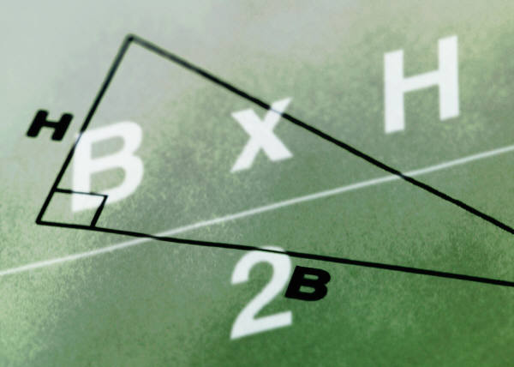
TRIGONOMETRY

Slide 37
TRIGONOMETRY
Value Points: 10 (4+6)
Type of expected questions | Marking Scheme | Common Mistakes committed by the students | Points to be Emphasised | Rating/Marks
1. Proving of identities | Solution usually involves 4 steps. Each step carries 1 mark | i. Do not use of the basic identities correctly e.g. sin²θ =1-cos²θ ii. Make mistakes in using correct T- ratios during simplification . | Students should be made to learn the basic identities thoroughly | Diffi- cult
2.Complementary angles (Internal choice in Q1 & 2) | i. Correct change of complementary angles 2 ii. Solution 1 iii. Answer 1 | i.. They write sin 55⁰ = sin (90⁰-55⁰) ii. Wrong values are substituted for sin30⁰, sin60⁰ etc. | i. Comp. angles to be applied directly. sin55⁰ = cos (90⁰-55⁰) ii. Values of T- ratios of 0⁰, 30⁰, 60⁰, 45⁰, 90⁰ are to be memorised. | Easy 4

Slide 38
TRIGONOMETRY
Type of expected questions | Marking Scheme | Common Mistakes committed by the students | Points to be Emphasised | Rating/marks
Height & Distance | i. Correct figure 1 ii. Solving the problem 4 iii. Writing the answer 1 | i. Angle nearer to 90⁰ is smaller than the angle farther than 90⁰ ii. Angle of depression is not marked in the figure if it is mentioned in the question iii. Unit of distance is not changed, if required in the question | a. Students should be told that angle of depression is equal to angle of elevation b. If in a question angle of depression is mentioned it should be marked in the figure c. Angle nearer to 90⁰ should be greater than the angle farther than 90⁰ d. Questions would not involve more than two right angled triangles e. Answer should be marked with proper unit as it carries one mark | Easy part is figure 1 mark

Slide 39
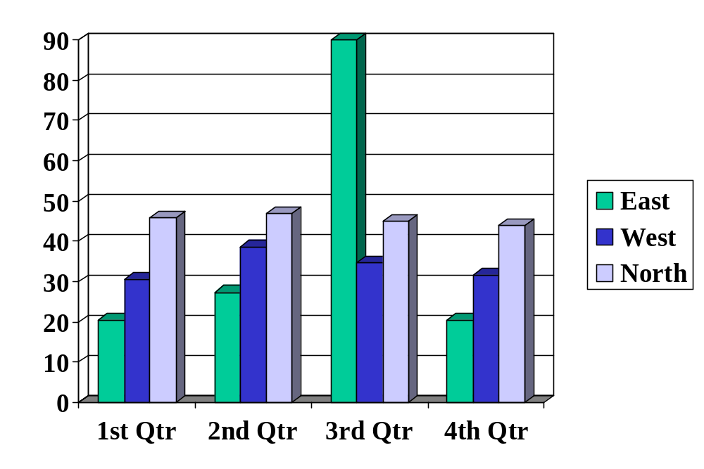
STATISTICS

Slide 40
STATISTICS
Sub-Topic : Mean
Value Points – 4(1)
Type of Expected Questions | Marking Scheme | Common Mistakes committed by the students | Points to be Emphasised | Rating/Marks
1. Finding the mean for discrete or continuous data | i. Writing correct value of x_{i}, f_{i}x_{i} 1½ ii. Finding sum of f_{i} , f_{i}x_{i} 1 iii.Correct formula ½ iv.Finding mean correctly ½ | i.They do not write the formulae ii. Calculation mistakes in finding the values of f_{i}x_{i}, sum of f_{i}x_{i} | i.They should learn the formulae ii.Lots of practice should be given for calculating f_{i}x_{i} and totalling | Easy 4
1.Finding the missing frequencies | i.Forming equations in missing frequencies 2 ii. Solving the equations and finding the missing frequencies 2 | They add the value of ‘p’ along with the data e.g. if sum of f_{i}x_{i} is 250+10p, they write it as 260p | i.They should be properly guided and given enough practice ii. Any method of finding the mean can be adopted

Slide 41
STATISTICS
Sub-Topic : Pie Chart
Value Points – 4(1)
Type of Expected Questions | Marking Scheme | Common Mistakes committed by the students | Points to be Emphasised | Rating / Marks
Reading the Pie chart | i.Finding the data using the central angle 4 | They divide the central angle with the data and multiply with 360º | Central angle of the pie chart should be divide by 360º and multiplied by the data | Easy 4
Drawing the Pie chart with the given data | i.Finding the Central angles from the given data 2 ii.Drawing the Pie chart correctly 2 | i. They do not make correct central angles specially when it is obtuse or more than 180º ii. They spend more time in beautifying the pie chart | i.They should be guided to make acute angles first ii. Beautification is not required iii. They should name the region correctly in the chart

Slide 42
STATISTICS
Sub-Topic : Probability
Value Points – 4(1)
Type of Expected Questions | Marking Scheme | Common Mistakes committed by students | Points to be Emphasised | Rating /Marks
Finding the probability | i.Total outcomes 1 ii. Favourable outcomes 1 iii. Finding probability 2 | i.They do not write the total outcomes of the event ii.They do not write the formula iii. They do the counting of outcomes in case of cards wrongly e.g. in case of cards numbered from 15 to 30, they count it as 15 instead of 16 | They should be given enough practice to write total outcomes, favourable outcomes, the formula and then the probability | Easy 4

Slide 43
COORDINATE GEOMETRY

Slide 44
CO-ORDINATE GEOMETRY
Value Points – 8 (4+4)
Type of Expected Questions | Marking Scheme | Common Mistakes | Points to be Emphasised | Rating / Marks
1.Finding a point on x-axis equidistant from two points 2.Showing the points are collinear 3. Proving a quadrilateral to be a Rectangle, square, parallelogram etc | i. Formula 1 ii. Solution 2½ iii. Writing answer ½ | i. They do not write formula correctly ii. Make mistakes in calculation iii. They do not find Sq. root correctly | i. More practice should be given for writing and applying the formula correctly ii. The students should learn to calculate square root correctly | Easy 4
Finding the value of ‘k’ when three points are collinear using section formula | i.Taking ratio p : 1 and finding the ratio 3 ii. Finding the value of ‘k’ 1 | i. They use distance formula instead of section formula for doing this question which involves lengthy calculations | i. They should use section formula for doing this question. | Average 2

Slide 45
TOPICS TO BE EMPHASISED
Finding the mean (Statistics)
Finding the missing frequencies (Statistics)
Reading & Plotting PIE - CHART (Statistics)
Use of Distance and Section Formula (Co-ordinate Geometry)
All Starred Theorems (Geometry)
Graphical Solution of Linear Equations (Algebra)
Instalments (Commercial Mathematics)

Slide 46
TOPICS TO BE EMPHASISED
8. Income Tax (Commercial Maths)
9. Factorisation – by splitting the middle term
10. Constructions (6)
11. Complementary Angles (Trigonometry)

Slide 47

WOW!!
Getting 65% in
Mathematics is
SO EASY!!

Slide 48
Acknowledgements:
Sh. B N Bajpai Chairperson ASG, DDE South
Mrs. Neelam Verma DDE (C), ADE (S), Member ASG
Dr. Mrs Suman Rekha E.O. Zone - 25, Member ASG
Mr. Devi Singh E.O. Zone - 14
Ms.Neelam Kapoor Lecturer, Mathematics
Mrs. Savita Vij TGT, Mathematics
Mrs. Kusum Dutta TGT, Mathematics
Mrs. Poonam Virmani Lecturer, Home Science
Mrs. Anju Mehta Lecturer, Home Science
Dr. Hemant Tahiliani TGT, Social Science

